Slide 1

Anti-Cheating Enforcement System (A.C.E.S) GitHub Classroom Tutorial

Slide 2
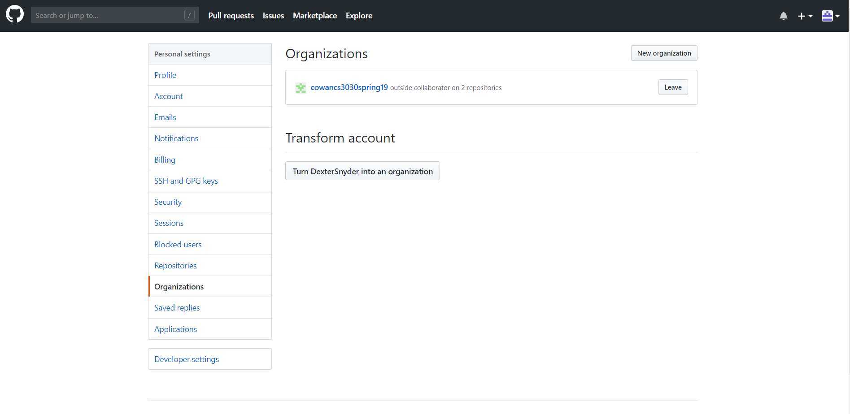
GitHub Classroom- Create Organization

Slide 3
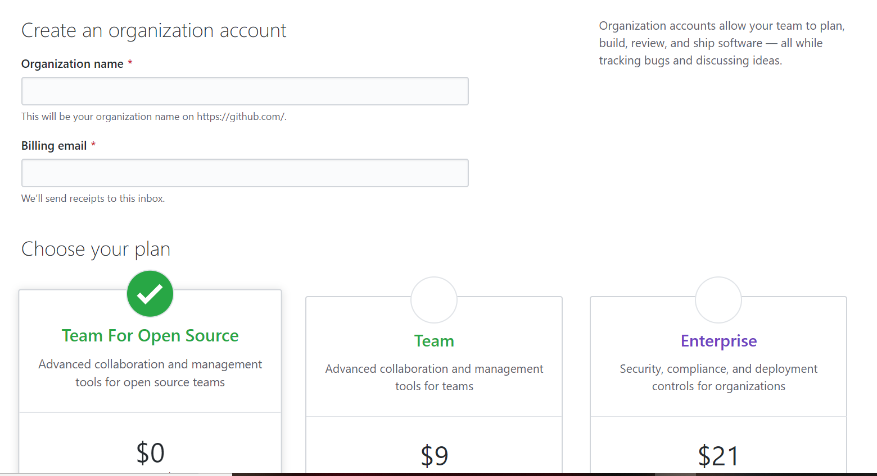
GitHub Classroom- Create Organization
A free account will work fine

Slide 4
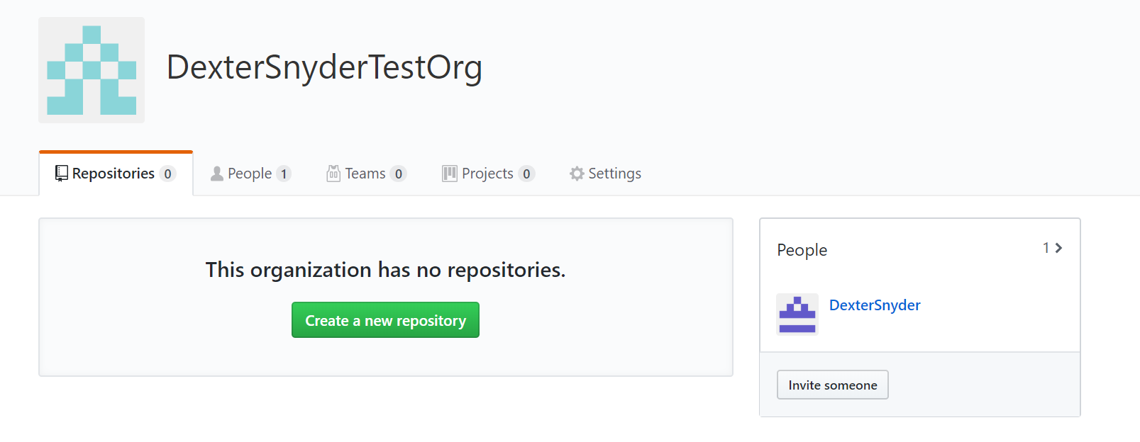
GitHub Classroom- Add Assignments
How you create a new repository depends on if you have an existing one or not. Make at least 1 before moving on.
Also, make sure to add *.opendb to the gitignore file, or Visual Studio will break the auto commit

Slide 5
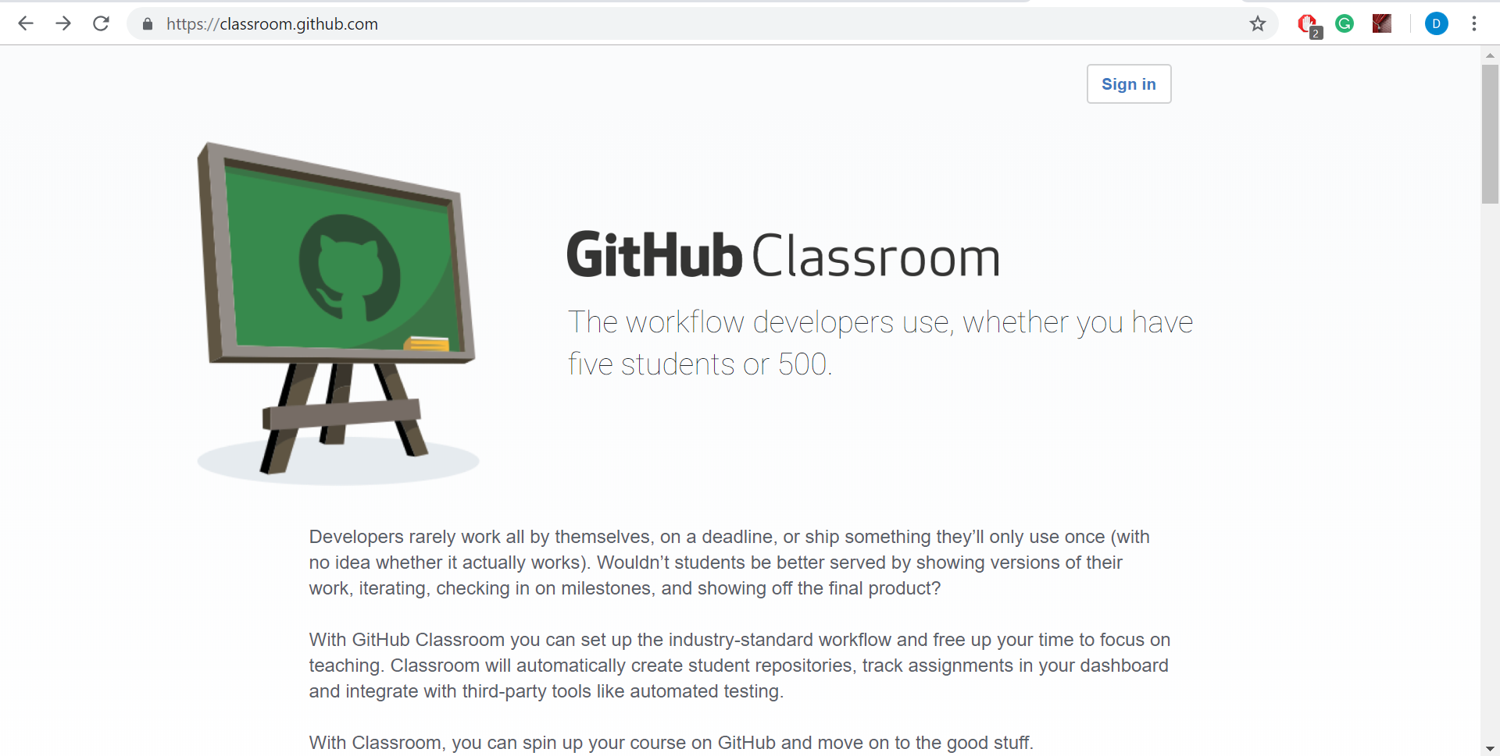
GitHub Classroom- Setup Class

Slide 6
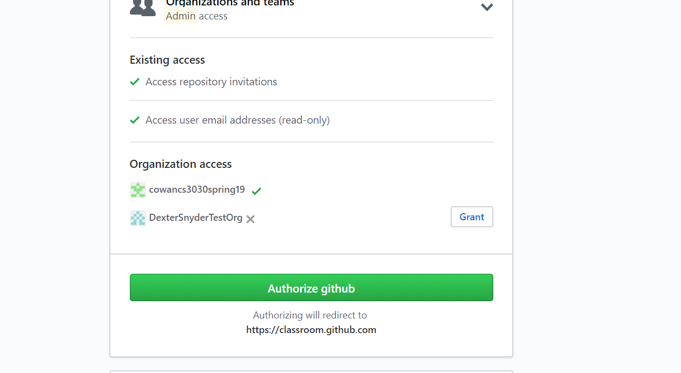
GitHub Classroom- Setup Class

Slide 7
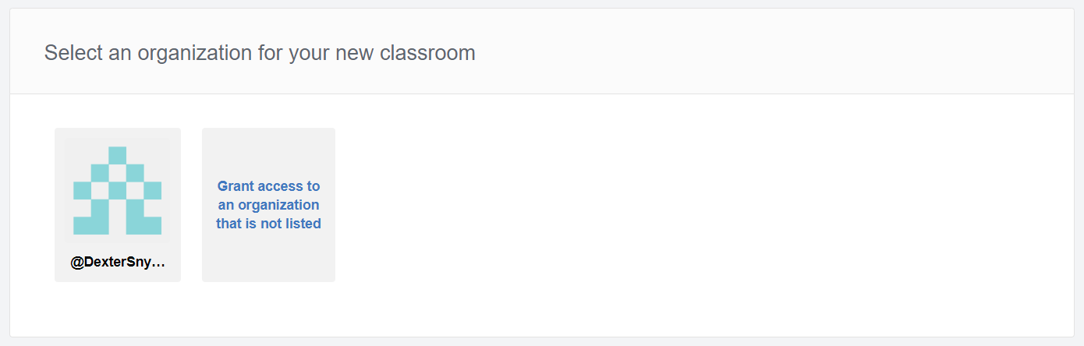
GitHub Classroom- Setup Class
Link to the organization that you created previously

Slide 8
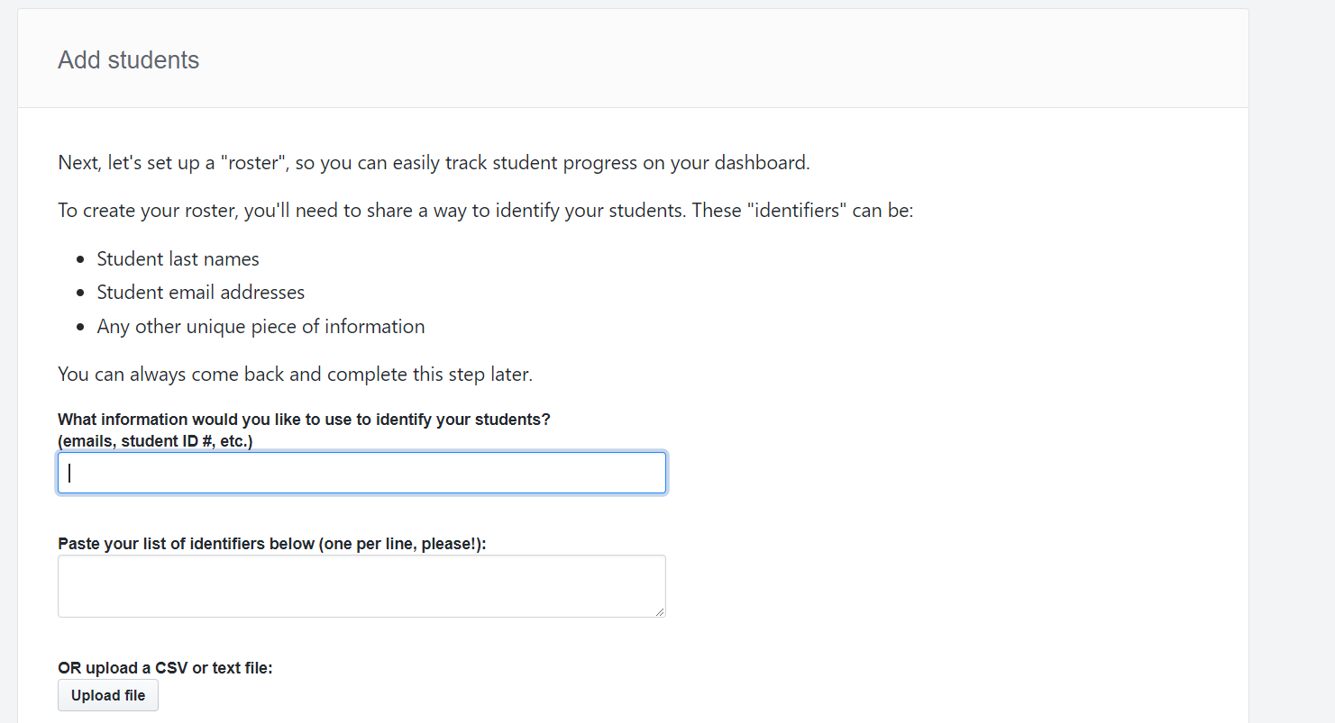
GitHub Classroom- Setup Class
Whichever identifiers you use will be how the students pick themselves off of a list

Slide 9
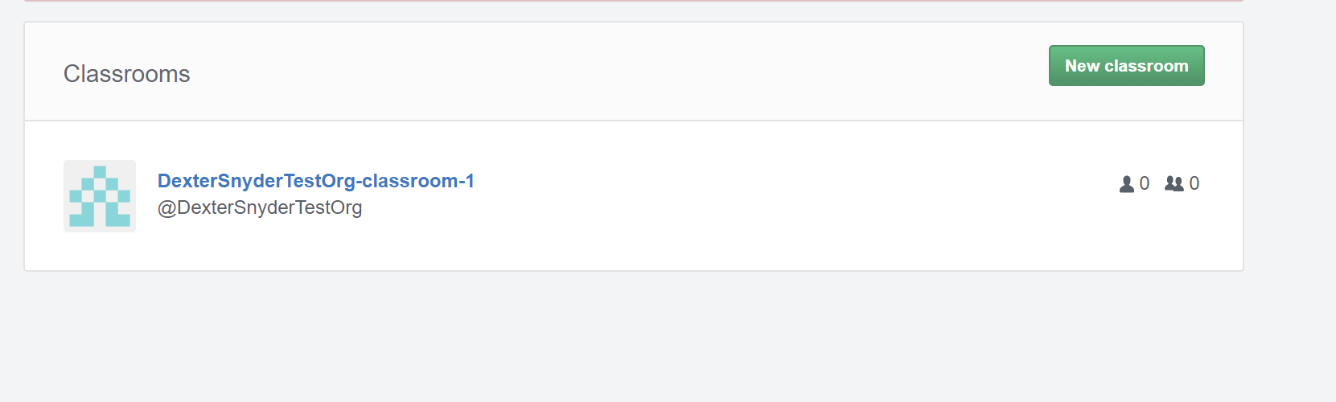
GitHub Classroom- Setup Class

Slide 10
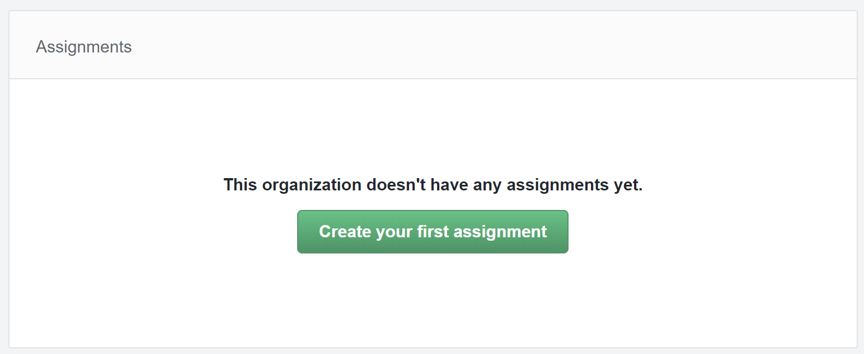
GitHub Classroom- Setup Class

Slide 11
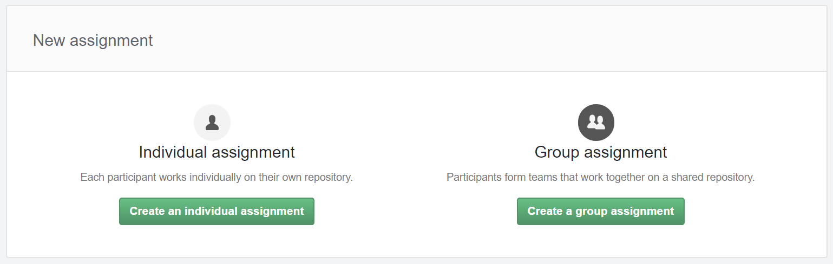
GitHub Classroom- Setup Class

Slide 12
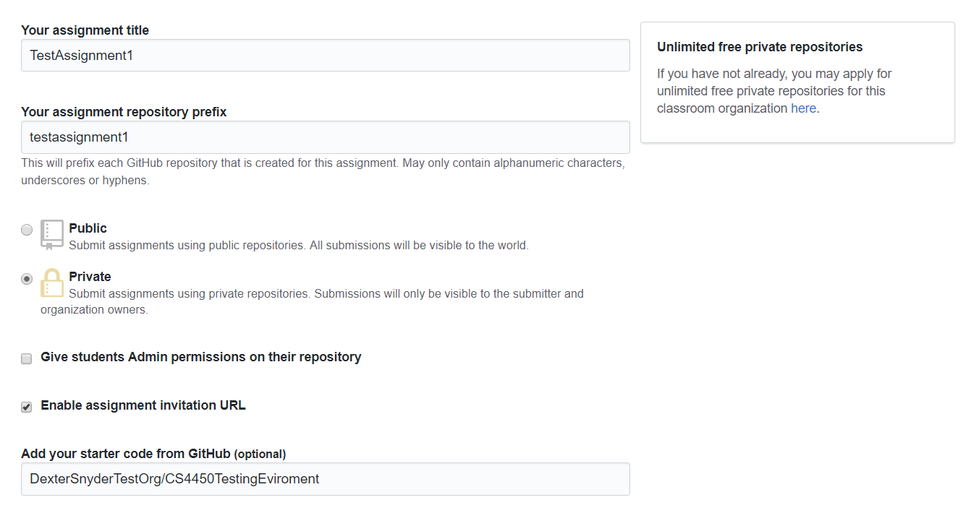
GitHub Classroom- Setup Class

Slide 13
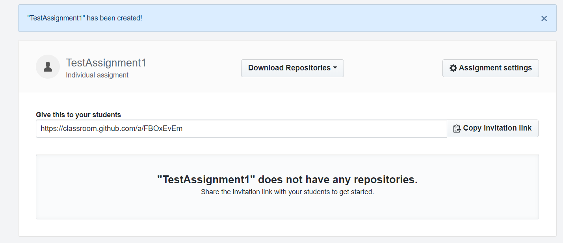
GitHub Classroom- Setup Class

Slide 14
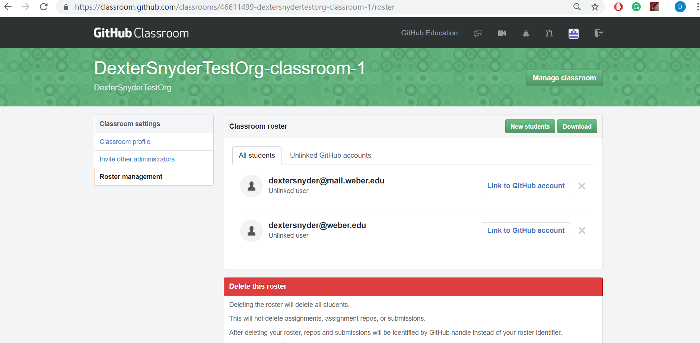
GitHub Classroom- Manage Class
Manage students here

Slide 15
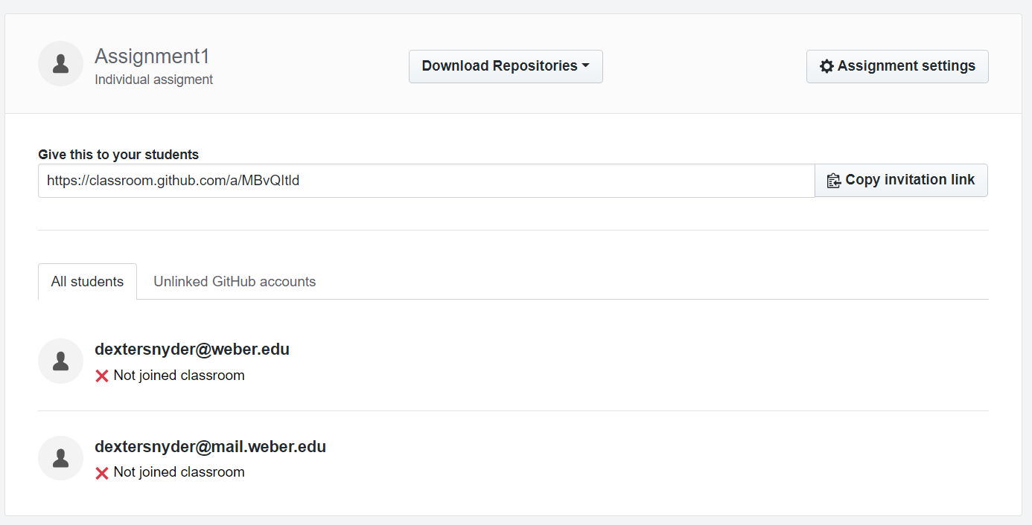
GitHub Classroom- Manage Class

